Slide 1
Introduction to Computer

Slide 2

What is computer?

Slide 3
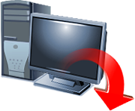
Computer
Is an electronic machine operating under the control of instructions stored in its own memory, that can accept data (input), manipulate the data according to specified rules (process), produce results (output), and store the result for use

Slide 4
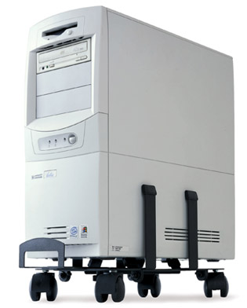
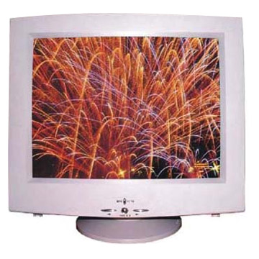
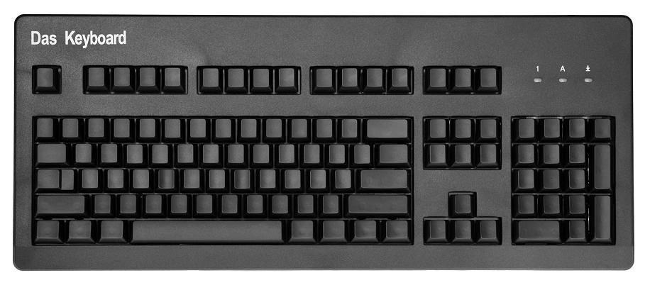
Major parts of computer

Slide 5
Data is collection of unorganized facts
Ex. numbers, characters, words, images, sounds
Information is data that is organized
Ex. reports, newsletter, receipt,

Slide 6
Data entered into a computer is called input.
The processed result are called output.
A computer processes input to create output, can hold data and information for future use in a area called storage.
This cycle of input, process, output, storage is called the information processing cycle

Slide 7

User
The person that communicates with a computer or uses the information it generates is called the user.

Slide 8
HARDWARE
Electric, electronic , mechanical equipment that makes up a computer.
Physical aspect

Slide 9
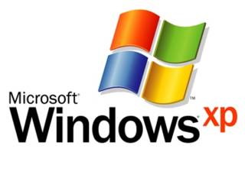
Software
Is the series of instruction that tells the hardware how to perform a task.
Serves as the interface between a user and the computer’s hardware
Key to productive use of computer, with the correct software a computer can be a valuable tool

Slide 10
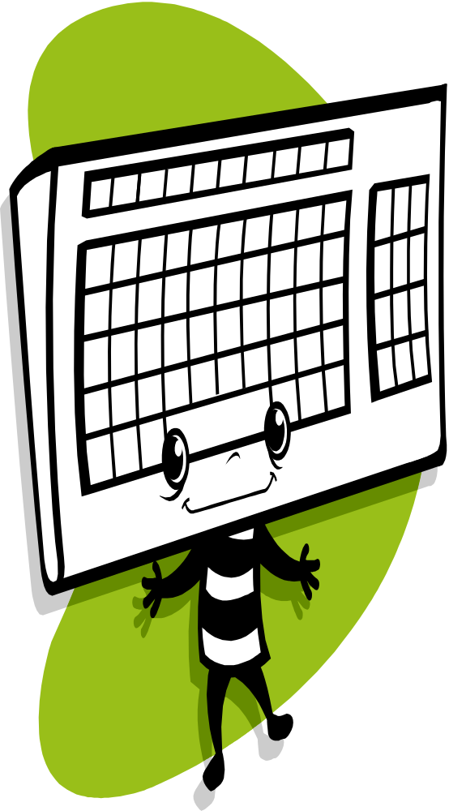


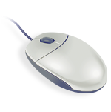
Components of a Computer
Input Devices - allows the user to enter data and commands into the memory of a computer.

Slide 11
Contains keys that allow you to type letters of the alphabet, numbers, spaces, punctuation marks, and other symbols.
It also contains special keys that allow you to perform specific functions on the computer.

Slide 12
Is a small handled device that contains at least one button.
Right click and left click
Controls the movement of a symbol on the screen.

Slide 13
Allow others to see you while communicating with you.
Allows you to speak to the computer in order to enter data and control the actions of the computer

Slide 14


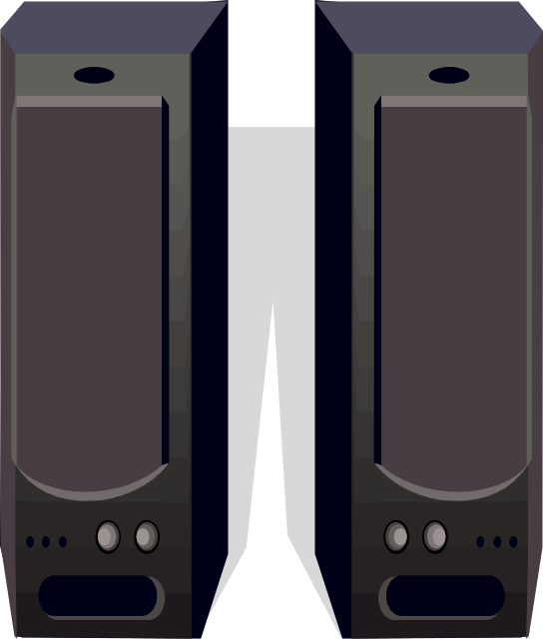
OUTPUT DEVICES
- An output device is used to convey the information generated by a computer to a user.

Slide 15
Produces text and graphics.
Used to display text and graphics
Allows you to hear music, voice, sounds generated by the computer

Slide 16
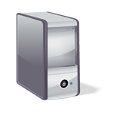
SYSTEM UNIT
The system unit is a box-like case made from metal or plastic that houses the computer electronic circuitry.

Slide 17
MOTHERBOARD
is the central or primary circuit board making up a complex electronic system,
is to provide the electrical and logical connections by which the other components of the system communicate.
Where the components of the CPU is attached or located

Slide 18
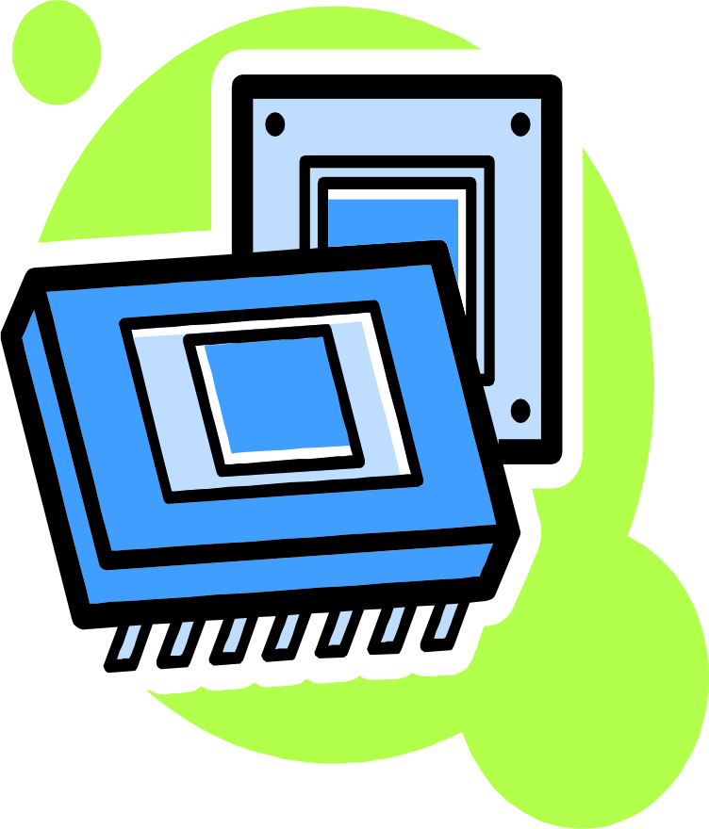
Two Main Component
Central Processing Unit (CPU)
/ Processor
- Is an electronic device that interprets or carries out the instruction.

Slide 19




Slide 20
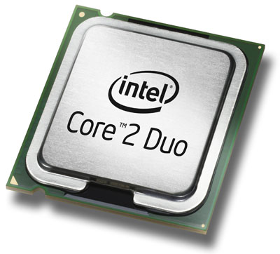

Slide 21
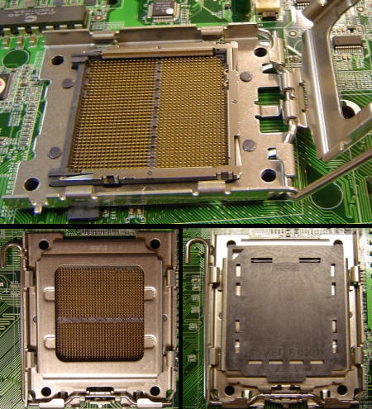

Slide 22
Memory is a series of electronic elements that temporarily holds data and instructions while they are being processed by the CPU/ Processor

Slide 23
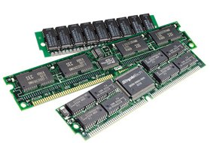

Slide 24
Some computer such as the processor and memory resided inside the system unit is called internal device.
Any external device attaches to system unit is called peripheral device.

Slide 25
Storage Device
Holds data, instructions and information for use. It holds these items permanently
Device is used to record and retrieve data, instructions and information.
Source of input
Hard disk, Floppy disk, CD/DVD ROM, USB MASS STORAGE.

Slide 26
HARD DISK provides much greater storage capacity than a floppy disk
It is usually consist of several circular disks on which data, instructions and information are stored magnetically. These disk are enclosed in airtight, which is located in system unit.

Slide 27
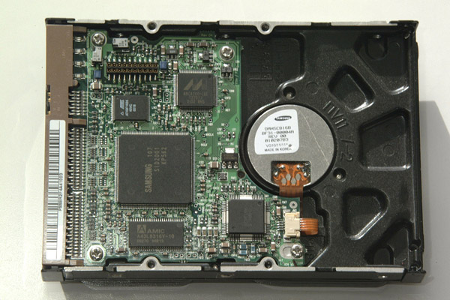

Slide 28
Compact Disc
Stores data using microscopic pits. Which are created by a laser light.
CD-ROM,DVD-ROM,CD-RW

Slide 29

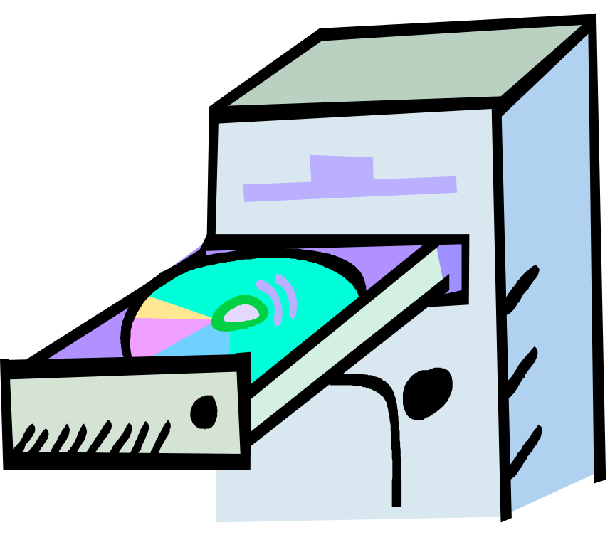
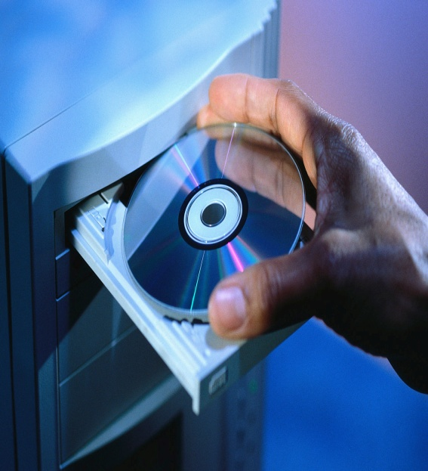
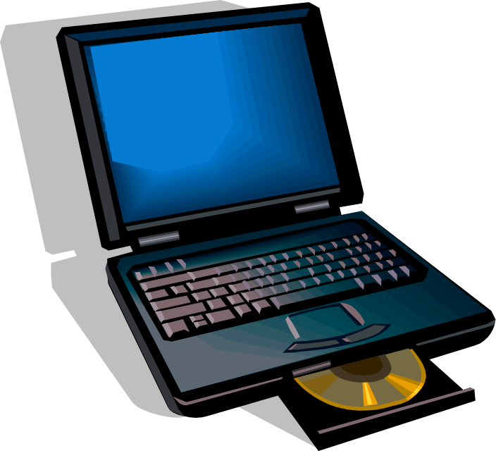


Slide 30
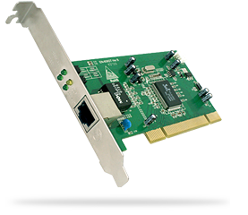
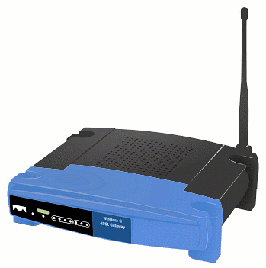
Communication Devices
Enable computer users to communicate and to exchange items such as data, instructions and information with another computer.

Slide 31

Why is a Computer a Powerful Tool?
Speed
Reliability
Accuracy
Storage
Communication

Slide 32
Categories of Software

Slide 33
System Software

Slide 34
OPERATING SYSTEM
contains instructions that coordinate all of the activities of hardware devices.
When you start a computer, the operating system is loaded, or copied, into memory from the computer’s hard disk.
It remains in memory while the computer is running and allows you to communicate with the computer and other software.

Slide 35


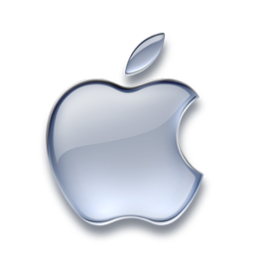

Slide 36

Utility Program
a type of system software that performs a specific task. usually related to managing a computer. its devices, or its programs.

Slide 37


User Interface
the part of the software with which you interact.
controls how data and instructions are entered and how information is presented on the screen.

Slide 38
Application Software

Slide 39
Common Application Software
Word Processing
Spread Sheet
Presentation Graphics
Database

Slide 40


PACKAGED SOFTWARE
designed to meet the needs of a wide variety of users, not just a single user or company.
sometimes is called commercial off-the-shelf

Slide 41
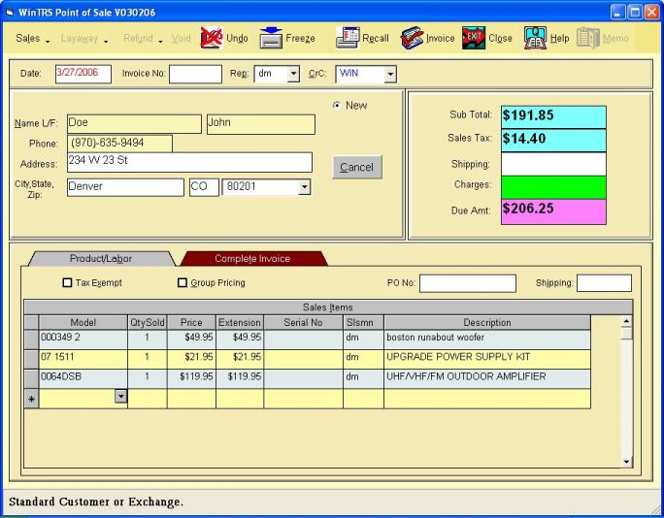
Custom Software
which is a program or programs developed at a user’s request to perform specific functions.

Slide 42
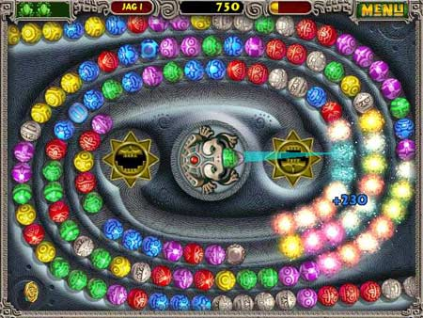
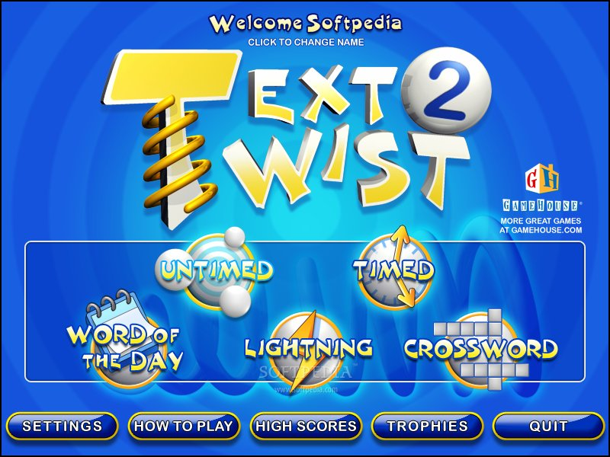
SHAREWARE
software that is distributed free for a trial period.

Slide 43

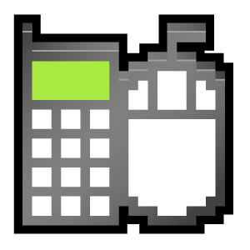
Freeware
software that is provided at no cost to a user by an individual or company.
freeware is copyrighted, meaning you cannot resell it as your own.

Slide 44


Public-Domain Software
free software that has been donated for public use and has no copyright restrictions.

Slide 45
Network and Internet

Slide 46
Network
a collection of computers and devices connected together via communications media and devices such as cables telephone lines, modems, or other means. Sometimes a network is wireless; that is, uses no physical lines or wires.

Slide 47


Internet
which is a worldwide collection of networks that links together millions of computers by means of modems, telephone lines, wireless technology, and other communications devices and media.

Slide 48
Categories of Computer

Slide 49
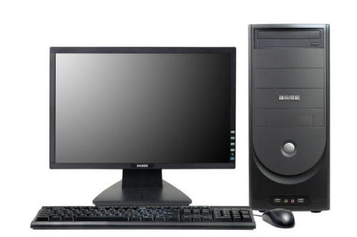
PERSONAL COMPUTERS
a computer that can perform all of its input, processing, output, and storage activities by itself; that is. it contains at least one input device, one output device, one storage device, memory, and a processor.

Slide 50
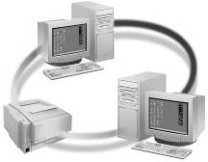
MINICOMPUTERS
A minicomputer, is more powerful and larger than a workstation computer.
Minicomputers often can support up to 4,000 connected users at the same time.

Slide 51
MAINFRAME COMPUTERS
a large, expensive, very powerful computer that can handle hundreds or thousands of connected users simultaneously.
store tremendous amounts of data, instructions, and information, which users can access with terminals or personal computers.

Slide 52
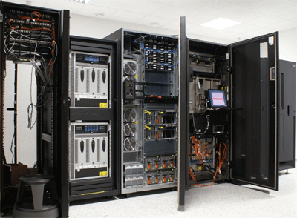

Slide 53
SUPERCOMPUTERS
super-computer is the fastest, most powerful computer - and the most expensive.
Capable of processing more than 64 billion instructions in a single second, supercomputers are used for applications requiring complex, sophisticated mathematical calculations.

Slide 54
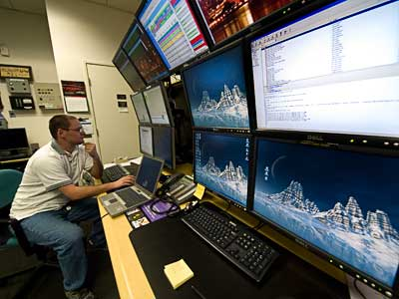

Slide 55
EXAMPLES OF COMPUTERS USAGE

Slide 56
Home Users
Small Business Users
Mobile Users
Large Business Users
Power Users

